Slide 1
Responsability of scientists in public matters Advising on Science C. Rossel
EPS Energy Group meeting, Rome, 23-24 Sept.2015

Slide 2
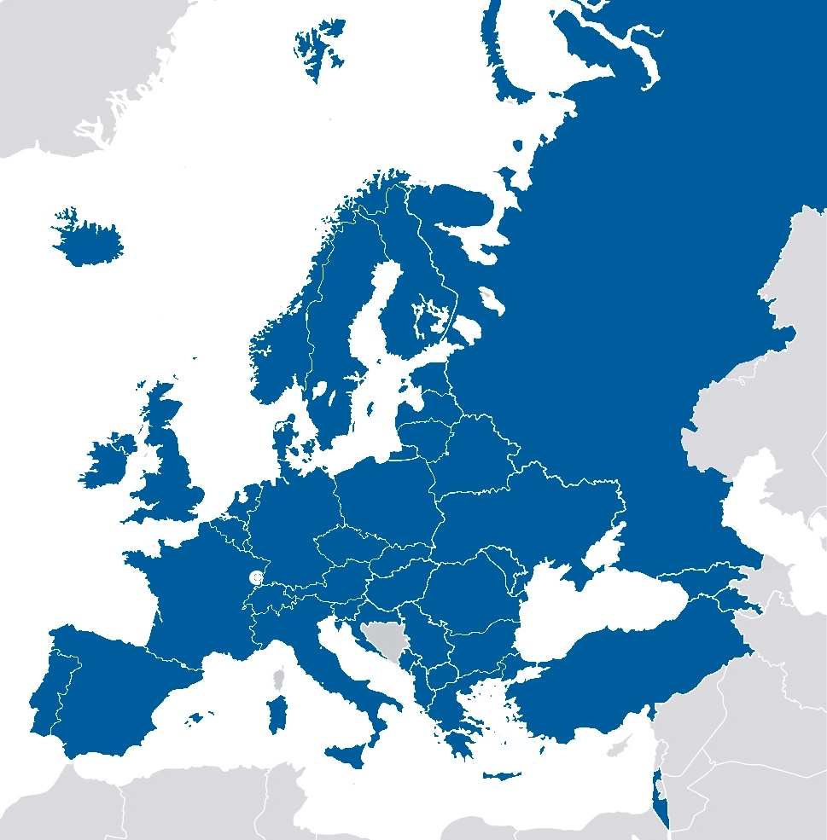
Membership in 2015
42 Member Societies
>3500 Individual Members
40 Associate Members (e.g. CERN, DESY, IOPP)
represent more than 130’000
physicists in EU

Slide 3
Key roles of EPS
Enhance cooperation with National Societies & Collaborating Societies
Define priorities and areas of most common interest such as funding of fundamental research, science & innovation programs, education and equal opportunity, outreach and promotion of talented students, physics students networks, links between industry and academia, large scale infrastructures, physics for development and north-south cooperation, etc..
Decide on strategic initiatives and get more involved in EU policies (research, energy, environment, health, ethics, etc.) and better represent physicists in Brussels (local office)

Slide 4
EPS Policies
EPS provides a forum for physics community in Europe to discuss
issues important to research and education and the relationship
between physics and society.
Through its broad membership base EPS represents the views
of the physics community in Europe.
EPS provides information to policy makers and general public
to understand issues from the point of view of physics on
Science and Research
Education
Energy and Environment
Physics and Society
Physics and Economy
European cooperation
International cooperation

Slide 5
Science in Europe (I)
Notes:
EuroScience is the non-profit grassroots association of researchers in Europe.
Open to European researchers across disciplines and countries, EuroScience undertakes to advance science and innovation in Europe, thereby promoting the interests of its thousands of members.
From its inception in 1997, EuroScience has been active in shaping policies for science, technology and innovation (STI), from the discussions leading to the European Charter and Code for Researchers, establishing the ERC, or the shaping of Horizon 2020 and its budget in the EU Financial Framework 2014-2020. EuroScience also plays a key role in RRI Tools, a major project on Responsible Research and Innovation
ESF > With 40 years’ experience in all areas of research, the European Science Foundation (ESF) was originally set up to act as a coordinating body for Europe’s main research funding and research performing organisations. But as the research landscape has evolved, so has ESF’s role in supporting scientific endeavours.
Science Europe is an association of European Research Funding Organisations (RFO) and Research Performing Organisations (RPO), based in Brussels. Its founding General Assembly took place in Berlin in October 2011.
The Initiative for Science in Europe (ISE) is an independent platform of European learned societies and scientific organizations whose aim is to promote mechanisms to support all fields of science at a European level, involve scientists in the design and implementation of European science policies, and to advocate strong independent scientific advice in European policy making.
Horizon 2020 is the biggest EU Research and Innovation programme ever with nearly €80 billion of funding available over 7 years (2014 to 2020) – in addition to the private investment that this money will attract. It promises more breakthroughs, discoveries and world-firsts by taking great ideas from the lab to the market.
The main goal of the European Research Council (ERC) is to encourage high quality research in Europe through competitive funding. In this section you can find out more about the ERC and the vital role it plays in supporting European leadership in world class research. The idea for establishing the ERC in 2007 first came out of widespread discussions between European scientists, scholars and research umbrella organisations at a time when no clear European mechanism to support basic research on a broad front existed. Yet to address this problem, Europe had to recognise the requirement for change and establish the necessary institutional structures for achieving it.
The International Council for Science (ICSU) is a non-governmental organisation with a global membership of national scientific bodies (122 Members, representing 142 countries) and International Scientific Unions (31 Members).
The League of European Research Universities (LERU) is an association of research-intensive universities. Founded in 2002, as a partnership among twelve multi-faculty research universities, in 2010 it expanded its membership to twenty-one. The purpose of the League is to influence policy in Europe and to develop best practice through mutual exchange of experience. LERU regularly publishes a variety of papers and reports which make high-level policy statements, provide analyses and make recommendations for policymakers, universities, researchers and other stakeholders

Slide 6
Science in Europe (II)
The future of European science is changing
how can Horizon 2020 further develop the EU as an attractive place for new, innovative research?
How can Europe stay an attractive region for new, young scientists?
What role will Horizon 2020 play in the development of Europe’s research infrastructures?
H2020 pillars: Excellent Science
Industrial Leadership
Policy & Research
Global Collaboration http://horizon2020projects.com/

Slide 7
Science in Europe (III)
17 members
8 members:
CERN - European Organisation for Nuclear Research
EMBL - European Molecular Biology Laboratory
ESA - European Space Agency
ESO - European Organisation for Astronomical Research in Southern Hemisphere
European XFEL - European XFEL Free-Electron Laser Facility
EUROfusion - European Consortium for the Development of Fusion Energy
ILL - Institut Laue-Langevin
Notes:
EuroScience is the non-profit grassroots association of researchers in Europe.
Open to European researchers across disciplines and countries, EuroScience undertakes to advance science and innovation in Europe, thereby promoting the interests of its thousands of members.
From its inception in 1997, EuroScience has been active in shaping policies for science, technology and innovation (STI), from the discussions leading to the European Charter and Code for Researchers, establishing the ERC, or the shaping of Horizon 2020 and its budget in the EU Financial Framework 2014-2020. EuroScience also plays a key role in RRI Tools, a major project on Responsible Research and Innovation

Slide 8
Science in Europe (IV)
And many more…! We are not alone !

Slide 9
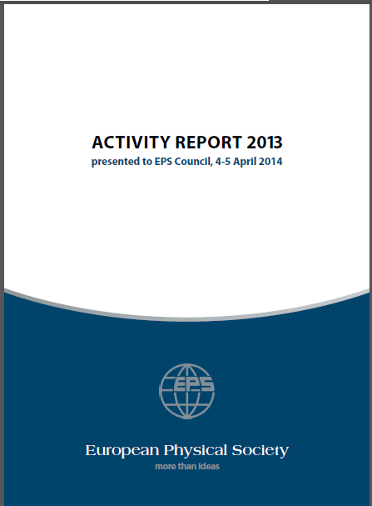
EPS activities
Some Numbers and Keywords in 2014
11 Divisions covering different sub-disciplines
7 Groups in areas of cross-cutting interest
5 Committees (e.g, Equal Opportunities, Forum Physics and Society, Young Minds, European Integration,…)
20 Prizes awarded
15 Conferences by EPS office and/or D&G
3 new Fellows
2 new Honorary Members
5 new Historic Sites
4 Journals and Publications EPL, EJP, EPN, eEPS
and …
IYL2015, Grants, Statements, International Relations, Joint Schools, …

Slide 10
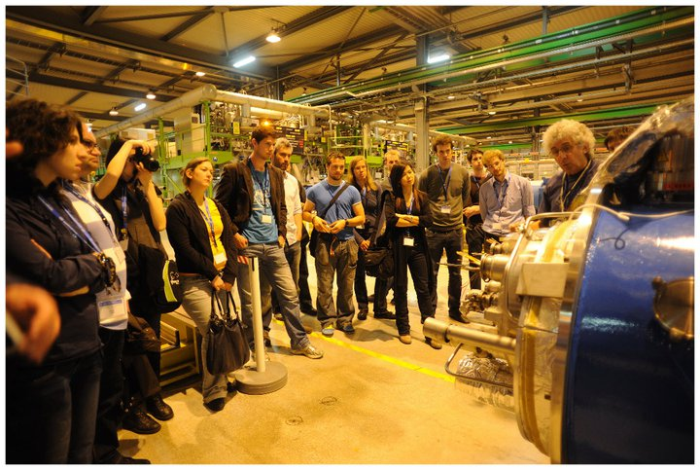
Young Minds
Modelled on OSA “student chapters” for…
International networking,
Young researchers in the scientific community,
Professional development
Promotion of science in local communities
Seminars & workshops
34 sections in 19 countries
Over 500 members
- 4 Leadership meetings
2014: EPS YM section involved in COST Network
for Young Scientists
This is a necessary structure for many regions and countries where no equivalent national organisation exists
SPAIN
ITALY
GERMANY
UK
UCRAINE
IRLAND
RUSSIA
FRANCE
US
SWITZERLAND
TURKEY
HUNGARY
DENMARK
THE NETHERLANDS
LATVIA
LITHUANIA
PORTUGAL
POLAND
CZECH REPUBLIC

Slide 11
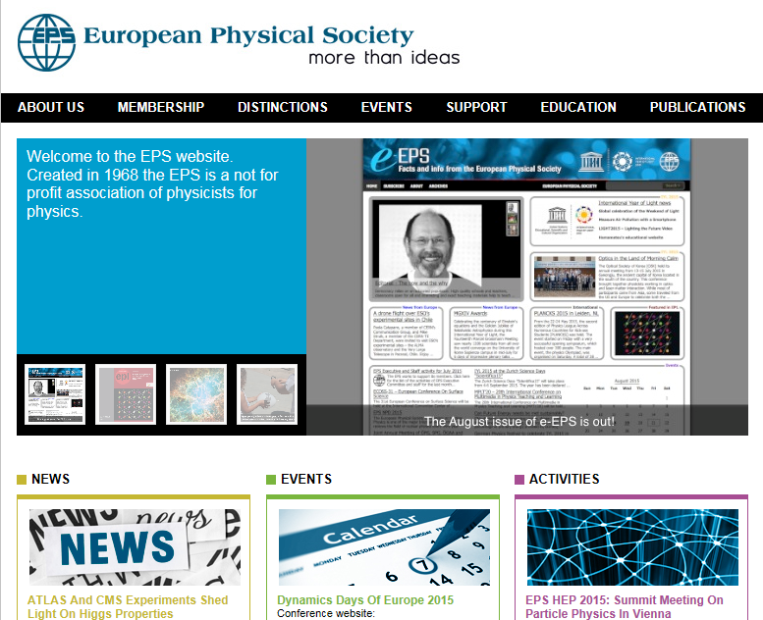
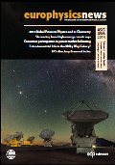
Communication
eps.org
epsnew.eu
EPN
278000 page views
35000 (monthly) subscribers
75000 website visits
27000 copies 6 / year

Slide 12
Editorials – Opinion columns
Advising on Science
Editorial of EPN 46/4
Science advisory at EU level is very important
Demonstrate that scientists are responsible and concerned by today’s
grand challenges
Provide objective scientific advices, based on careful studies
Communicate better with politicians
Follow the codes of scholarly conduct and ethical behaviors
Show the good example and keep a respectful attitude in front of the
public opinion
EPS provided nominations for new Science Advice Mechanism
of the European Commission
Notes:
EuroScience is the non-profit grassroots association of researchers in Europe.
Open to European researchers across disciplines and countries, EuroScience undertakes to advance science and innovation in Europe, thereby promoting the interests of its thousands of members.
From its inception in 1997, EuroScience has been active in shaping policies for science, technology and innovation (STI), from the discussions leading to the European Charter and Code for Researchers, establishing the ERC, or the shaping of Horizon 2020 and its budget in the EU Financial Framework 2014-2020. EuroScience also plays a key role in RRI Tools, a major project on Responsible Research and Innovation

Slide 13
EPS Statements & Reports
2012: On the Use of Bibliometric Indices in Assessment
2013: Opportunities in Horizon 2020
2013: Managing the Transition to Open Access
2013: Physics and Economy Report
2014-15: Importance of Nuclear Science in the Preservation of Cultural Heritage
2014-15: On the Importance of Funding Basic Natural Science
2015: European Energy Policy and Global Reduction of CO2 emissions

Slide 14
EPS Statements & Reports 2015
On the Importance of Funding Basic Natural Science
Basic science is valuable to modern society and contributes significantly to economic, cultural and social development. Those engaged in fundamental research have the obligation to explain to governments, agencies, and tax payers the importance of support for basic science, even in a time of austerity.
European Energy Policy and Global Reduction of CO2 emissions
Towards an effective sustainable electricity production in Europe
Recommendations by EPS Energy group before UN CC Conference in Paris -Dec. 2015
- Policy to promote renewable energies for electricity generation & energy efficiency measures.
- Global agreement for reduction of CO2 emissions worldwide
- Revisit of the 2050 Energy Roadmap

Slide 15
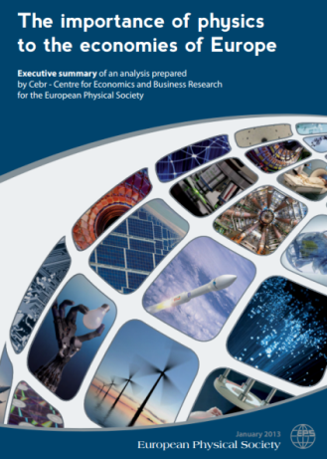
Physics and EU Economies
EPS report 2013, over years 2007-2010,
in 27 EU countries + CH & NO
Physics-based industries are defined as those sectors of the European economy where the use of physics – in terms of technologies and expertise – is critical to their existence
Electrical, civil, & mechanical engineering
Energy& environment
Information technology & communications
Design & manufacturing
Transportation
Medicine & related life-science fields
Technologies used in space

Slide 16
How to advice politicians
12 practical tips (Physicsworld 28 (8) August 2015)
Be aware that scientists are often seen as just another lobby group
Know how government policy-making is structured
Realize that science is not the only, or even the major, consideration
Point out the role of your specialty in solving cross-disciplinary problems
Appreciate the importance of personal contact
Be aware of political priorities and the need to engage with them
Be aware of political timescales
Offer options, not policies
Don’t over-claim, avoid making predictions
Keep it as simple as possible, but not simpler
Be aware that ‘more research’ is seldom an option
Establish long-term gain, follow incremental developments

Slide 17
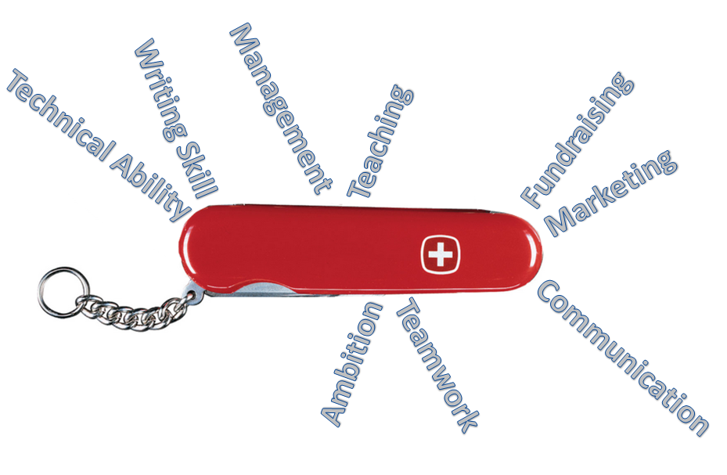
Skills needed by scientists

Slide 18
Knowledge and value changes
In today’s global, knowledge-based and interconnected world
Our decisions are still strongly influenced by cultural values
The system of values is defined by nationality, religion, ethnical origin,
and political structure
In Western EU the society is based on individualism, freedom, financial
and professional success, science and technology
Novel post modern values or green values are coming up, based on
better concern for preservation of our resources and environment
Our energy future relies on two types of people: those convinced by the
financial-technical potential of renewable energies and those motivated
by essential values related to climate change, environmental impact and
preservation of our planet.
The change in the social, economical and ecological values requires
more scientific expertise and more engaged individuals with visions

Slide 19
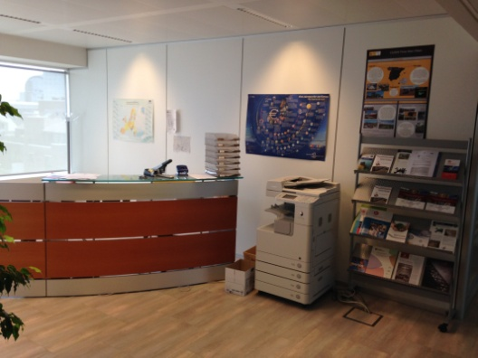
EPS in Brussels
EPS Objectives
Set up a list of action priorities
Advocate for physics and its role in solving socio-economic challenges
Provide expert advice on issues related to physics and science policies to EU institutions
Increase visibility and impact of EPS via its office
Organize policy sessions at EPS meetings to inform, consult and debate → 2 October meeting of MSs’ presidents
Respond to specific requests of the member organizations, host some of their events in Brussels office.
CSIC
Notes:
Horizon 2020 is the biggest EU Research and Innovation programme ever with nearly €80 billion of funding available over 7 years (2014 to 2020) – in addition to the private investment that this money will attract. It promises more breakthroughs, discoveries and world-firsts by taking great ideas from the lab to the market

Slide 20
EPS in Brussels
The Investment Plan for Europe (ESFI) aims to revive investment in strategic projects around Europe by mobilizing € 315 billion for the period 2015-2017.
Commission’s plan
use €2.7 billion from Horizon 2020 fund (3.5% of €80 billion)
€3.3 bn from Connecting Europe Facilities (CEF)
€2.0 bn from EU budget margin etc.
claim → x15 (3x5) multiplication factor of seed capital by attracting additional investments in areas including infrastructure, education,
research, innovation, renewable energy and energy efficiency.
adopted by Union legislators, European Parliament and Council ! (June 2015)
Notes:
The European Fund for Strategic Investments (EFSI) will mobilise additional investments in the real economy in areas including infrastructure, education, research, innovation, renewable energy and energy efficiency. It will also focus on SMEs and mid-cap companies (companies with between 250 and 3000 employees). The EFSI should target projects that promote job-creation, long-term growth and competitiveness. The proposal also sets up a European Investment Advisory Hub (EIAH) to provide advisory support to project identification, preparation and development across the Union. Finally, a European Investment Project Pipeline will improve investors' knowledge of existing and potential future projects, with no guarantee that these projects will be financed by the EFSI.

Slide 21
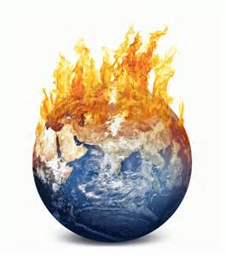
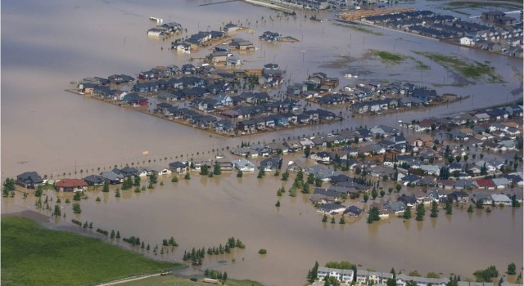
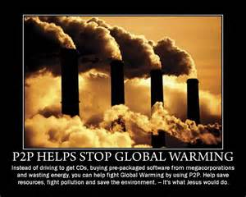
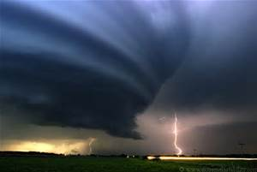
One example - Facing angry climate
‘Humans have benefited greatly from a stable climate for the last 11,000 years
– roughly 400 generations. Not anymore. We now face an angry climate.
One that we have poked in the eye with our fossil fuel stick and awakened.
Now we must deal with the consequences. We must set aside our differences
and prepare for what we can no longer avoid. And that is massive disruption to
our civilizations’. (Prof. Paul Beckwith, University of Ottawa, 2013)
It is well past the time that politicians and governments need to act to address these issues….
WHAT can we do better than the thousands of GOs and NGOs worldwide?

Slide 22
Facing angry climate
Greenhouse gases that humans are putting into the atmosphere from burning fossil fuels are trapping extra heat in the earth system (distributed between the oceans (93%), the cryosphere (glaciers, ice sheets, sea ice for 3%), the earth surface (rocks, vegetation, etc. for 3%) and the atmosphere (only an amazingly low 1%).
Global temperatures have increased (on average) about 0.17 ºC per decade but the Arctic has increased > 1 ºC per decade, or about 6x faster.
Equator-to-Arctic temperature difference is thus decreasing rapidly.
Less heat transfer occurs from equator to pole (via atmosphere, and thus jet streams become streakier and wavier and slower in west-to-east direction, and via ocean currents
Storms (guided by jet streams) are slower, sticking and, with more water content, are dumping huge torrential rain quantities on cities and widespread regions at higher latitudes than is “normal”.
A relatively rare meteorological event called an “atmospheric river” is now much more common, and injects huge quantities of water over several days to specific regions
http://www.boomerwarrior.org/2013/10/we-now-face-an-angry-climate-paul-beckwith/

Slide 23
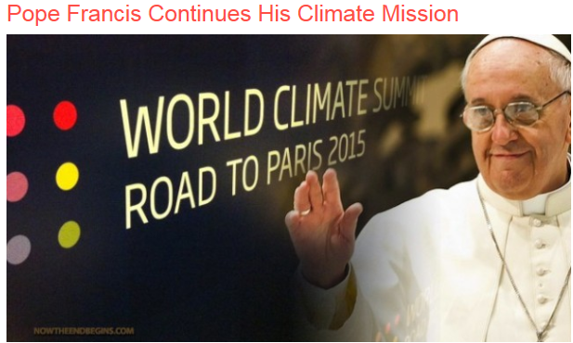
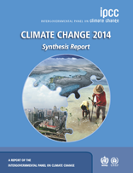
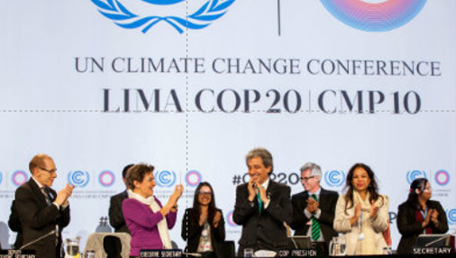
Facing angry climate

Slide 24
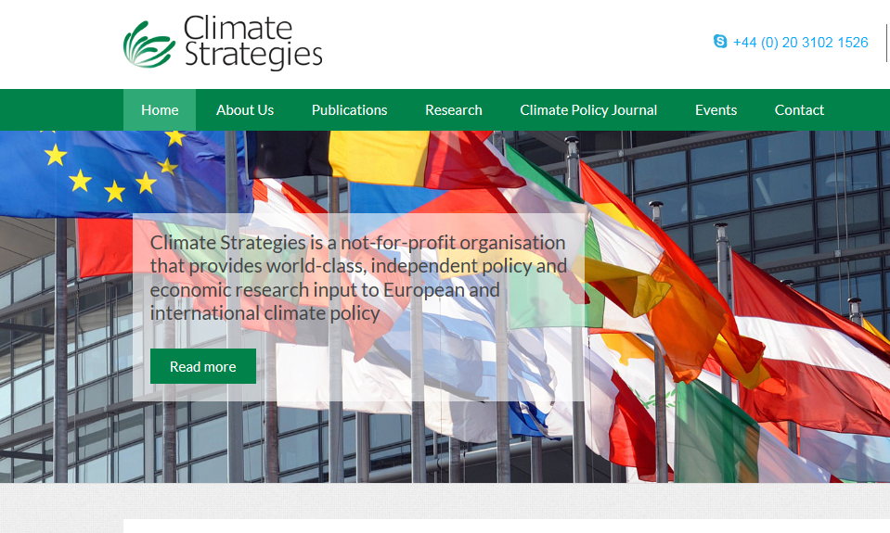
Facing angry climate

Slide 25
Facing angry climate
Angry Birds and Earth Day Network Announce New In-Game Experience to Fight Climate Change for 45th Anniversary of Earth Day
Notes:
Angry Birds and Earth Day Network Announce New In-Game Experience to Fight Climate Change for 45th Anniversary of Earth Day The experience will be integrated into an Angry Birds title during the General Assembly of the United Nation events in New York this September when world leaders will announce sustainable goals around climate, in advance of COP 21 in Paris.
Rovio Entertainment, in cooperation with the Earth Day Network, will announce Angry Birds' "Champions for Earth" – an awareness driving in-game experience – at Global Citizen 2015 Earth Day, on April 18th, at the National Mall. The experience will be integrated into the game in September timed to the General Assembly events in New York. As world leaders, including the Pope and United Nations dignitaries, work through climate issues to announce sustainable goals– there will be playable content aimed to engage the millions of Angry Birds players around the globe during this discussion

Slide 26
Conclusions
Physics has been for centuries one of the important drivers of our society, with constant progress in knowledge, discoveries, innovation and technology .
The impact of physics on our economy is enormous
Advising on Sciences needs good communication skills, open interlocutors between scientists and politicians
But EPS is not alone in the EU landscape and therefore needs a strong involvement of its Divisions, Groups and Committees in providing scientific evidences and statements for the EU organizations in Brussels and national governments.

Slide 27
Questions & Discussion

Slide 28
Mission for EPS
Political Strategies
Contribute to and promote the advancement of physics in all issues related to research, science policy, education , public
outreach, and to a sustainable environment (Energy, Climate)
Focus on EPS Strategy Plan 2010+ and upgrades until 2016
Enhance EPS visibility to European policy makers with presence in Brussels (office of political affairs, communication)
Strengthen the role of EPS as a Federation of MSs and AMs
Assess the importance of physics and ‘industrial physicists’ in the technological and economical development of our world
Develop cooperation & collaboration in and outside Europe
Use Int’l Year of Light 2015 and other similar initiatives to
promote education, career development and gender equality

Slide 29
Mission for EPS
Operational Strategies
Increase membership of IMs and AMs (create industry pool) and benefits offered by EPS
Keep balanced relationship to all National Societies (big & small)
Strengthen communication among Divisions, Groups and IMs
Support publication activities (EPN, e-EPS, EPL, EJP)
Support conference activities
Target young generations of students with modern communication means, involving EPS Young Minds
Improve presence of EPS in media, internet, science museums, etc.

Slide 30
Mission for EPS
Financial and human resources
Assess financial structure & optimize budget
More income from IMs, AMs and perhaps from Conference Service Department
Work closely with Secretariat’s staff to monitor progress and evaluate improvement potential
New staff for political affairs & international relations

